Slide 1
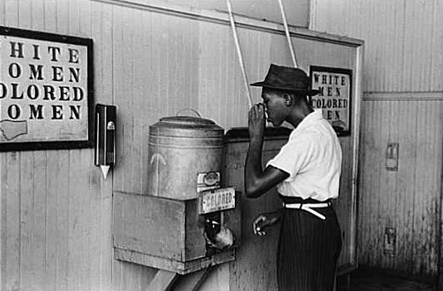
SC Decision Making

Slide 2
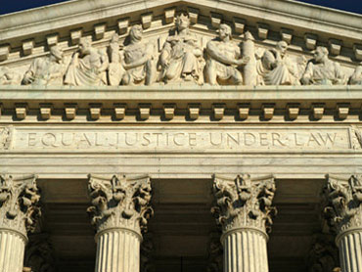
Procedures
Terms begin in Oct
Sit 2 weeks straight listening to lawyers give their side
Then work privately on cases and writing their decisions
Only hear 1% of cases each year

Slide 3
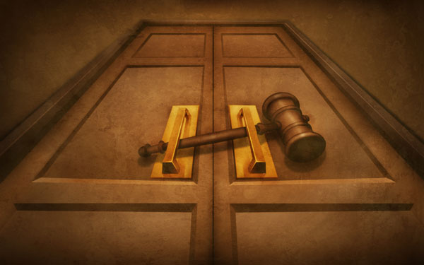
Writ of Certiorari
SC orders a lower court to send them the case
Either error or big issue
See about 10% of these cases

Slide 4
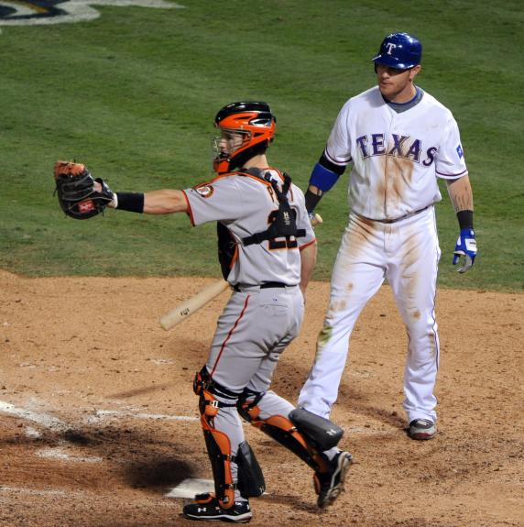
Appeals
To review a decision made by a lower court
Very few cases heard this way

Slide 5
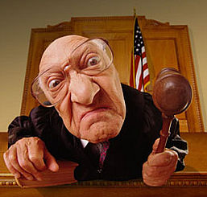
Selecting Cases
Discuss List – cases justices discuss on whether to hear or not
4 of 9 justices to take on a case
Make quick decision based on facts or hear more
Steps to making decision….

Slide 6
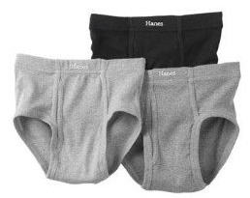
Submitting Briefs
Both sides present a brief – legal arguments and relevant facts
Outside parties then submit their info if its useful and pertains to the case

Slide 7
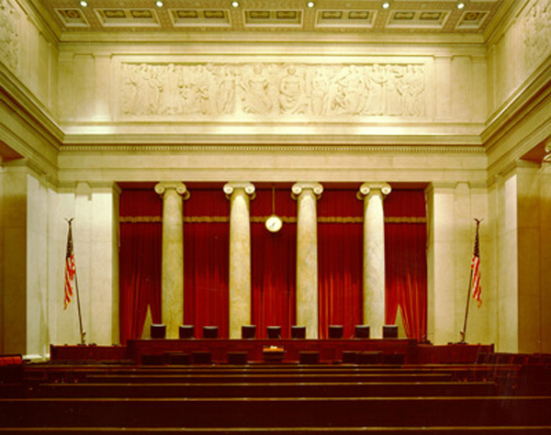
Oral Arguments
Each side has a lawyer give best arguments
30 minutes to speak
5 minute warning
Red light comes on you have to shut up immediately

Slide 8
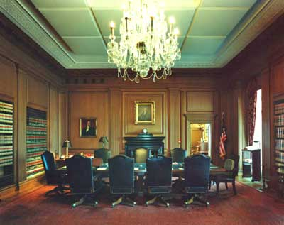
The Conference
No meeting notes kept (just talk)
Each justice votes in order of seniority
Majority vote needed and at least 6 must be present

Slide 9
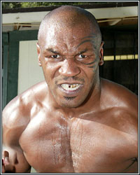
Writing the Opinion
Facts, Decision, and why
Unanimous – a third of all cases
Majority Opinion – those on winning side
Dissenting Opinion – those on losing side

Slide 10
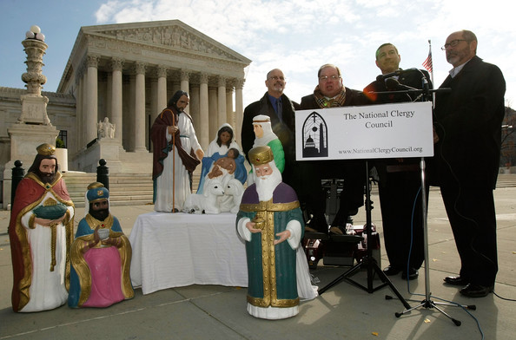
Shaping Public Policy

Slide 11
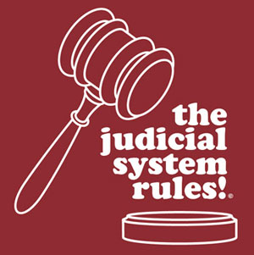
Judicial Review
Examine laws and cancel them if they violate the constitution
State and local laws evaluated mostly
1270 since 1789

Slide 12

Interpretation of Laws
Interpret existing laws
Casey Martin golfer
Civil Rights Laws
Etc Etc Etc

Slide 13
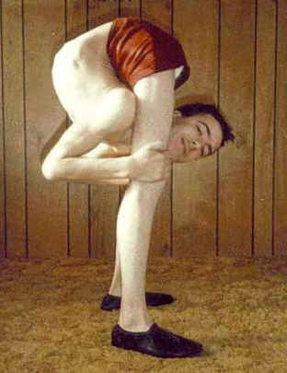
Overturning Decisions
Precedents set and a model for future decisions
Need to be flexible and able to adapt

Slide 14
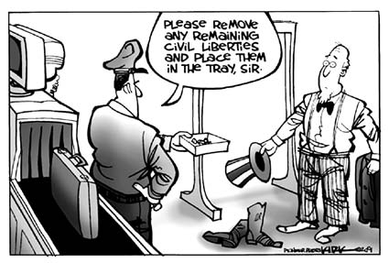
Limits on the Types of Issues
Very little foreign policy
Constitutional issues
Economical issues
National Gov’t vs State Gov’t

Slide 15
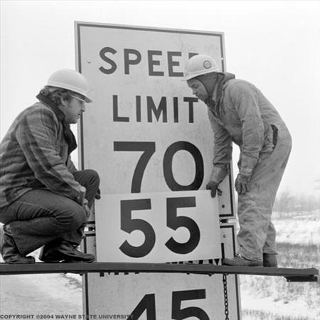
Limits on Types of Cases
Decision must make a difference
Plaintiff must have suffered harm
Must affect many people or a political system
Must be something executive & legislative branches cant fix

Slide 16

Limited control over agenda
Events control the agenda
SC may want to rule on something but cant until an event occurs and is brought to them

Slide 17

Lack of Enforcement Power
No way to enforce their rulings
Cannot monitor the millions of people their rulings affect

Slide 18
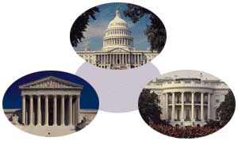
Checks and Balances
President appoints justices
Senate approves justices
Congress can impeach justices

Slide 19
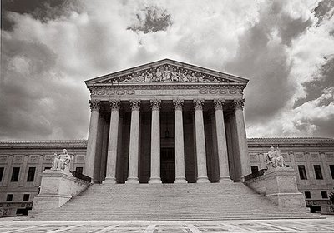
Influencing Court Decisions

Slide 20
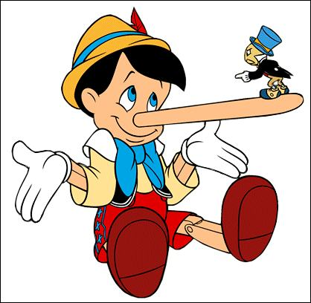
Basing Decisions on Law
Can’t be opinion based, must be on facts and law

Slide 21
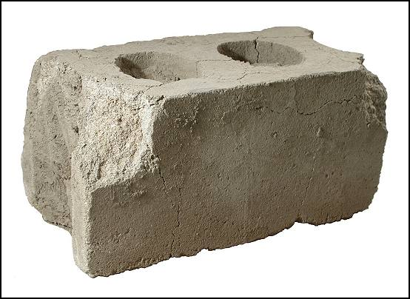
Views of the Justices
Each justice has their own views and the ones they believe strongest in
Bloc – justices with common views
Swing Vote – deciding vote

Slide 22

Relations among the Justices
Harmony – find common solutions to problems
Conflicts will never be open to public
Chief Justice – can influence others by what is discussed

Slide 23

The Court and Society
SC makes decisions based on concern for public support
SC decisions can and will change as society changes

Slide 24
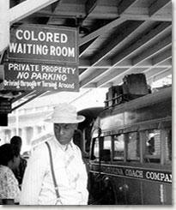
Plessy v. Ferguson
1896 – whites and blacks segregated on trains
Service in WW2 and damages to African American children change society
Brown v Board of Ed. – changes segregation laws

Slide 25
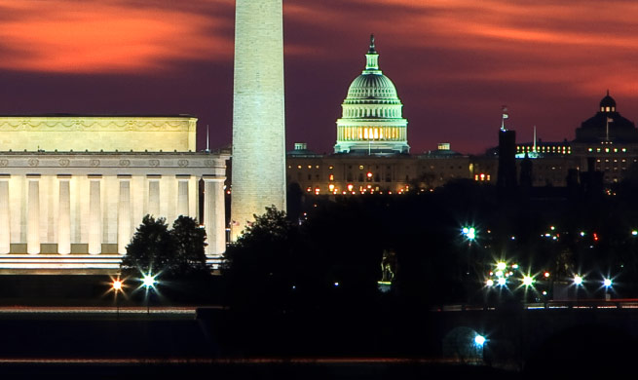
Congress’s Influence
Bills to limit their power
Create laws in different forms if found unconstitutional
Propose amendments
Deny raise to justices

